Slide 1

CS47: Cross-Platform Mobile Development
Lecture 4B: AsyncStorage, SecureStore and PouchDB
James Landay
Abdallah AbuHashem
Tiffany Manuel
Cisco Vlahakis
Vy Mai
Fall 2019
https://cs47.stanford.edu
cs47-fall19.slack.com

Slide 2

Overview for today
AsyncStorage
SecureStore
PouchDB
Build a to-do list

Slide 3

Overview for today
AsyncStorage
SecureStore
PouchDB
Build a to-do list

Slide 4
AsyncStorage
A simple, unencrypted, asynchronous, persistent, key-value storage system that is global to the app.

Slide 5

AsyncStorage
A simple, unencrypted, asynchronous, persistent, key-value storage system that is global to the app.
.
.
.
.
.
.
.
Loc : CA
.
.
Age : 20
Loc : CA
Hei : 175
Name : Abd
Fav : World
Wei : 75
Tinder
NYT
Jedi ID

Slide 6
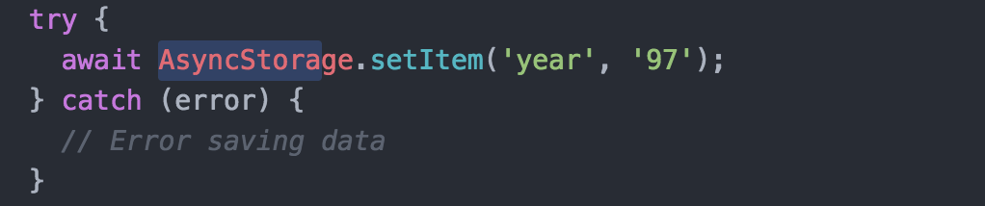
Using AsyncStorage
Pushing Data
.
.
.
Hei : 175
Wei : 75
Jedi ID

Slide 7
Using AsyncStorage
Pushing Data
year : 97
.
.
.
Hei : 175
Wei : 75
Jedi ID

Slide 8
Using AsyncStorage
Pushing Data
year : 97
Hei : 175
Wei : 75
Jedi ID

Slide 9
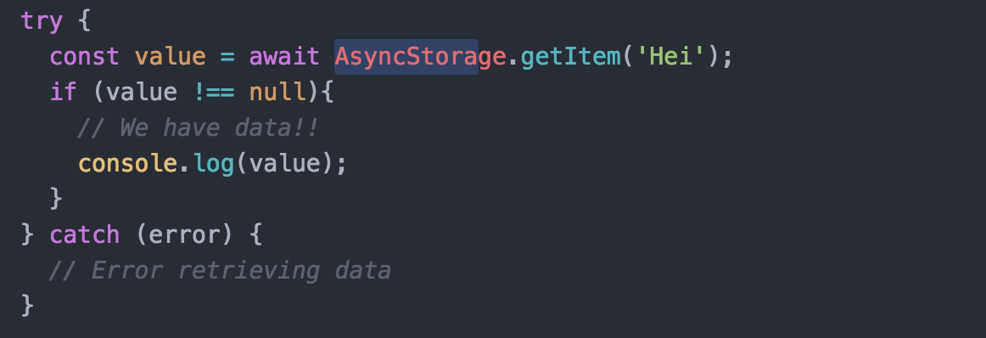
Using AsyncStorage
Pushing Data
Fetching Data
year : 97
Hei : 175
Wei : 75
Jedi ID

Slide 10
Using AsyncStorage
Pushing Data
Fetching Data
year : 97
‘175’
Hei : 175
Wei : 75
Jedi ID

Slide 11
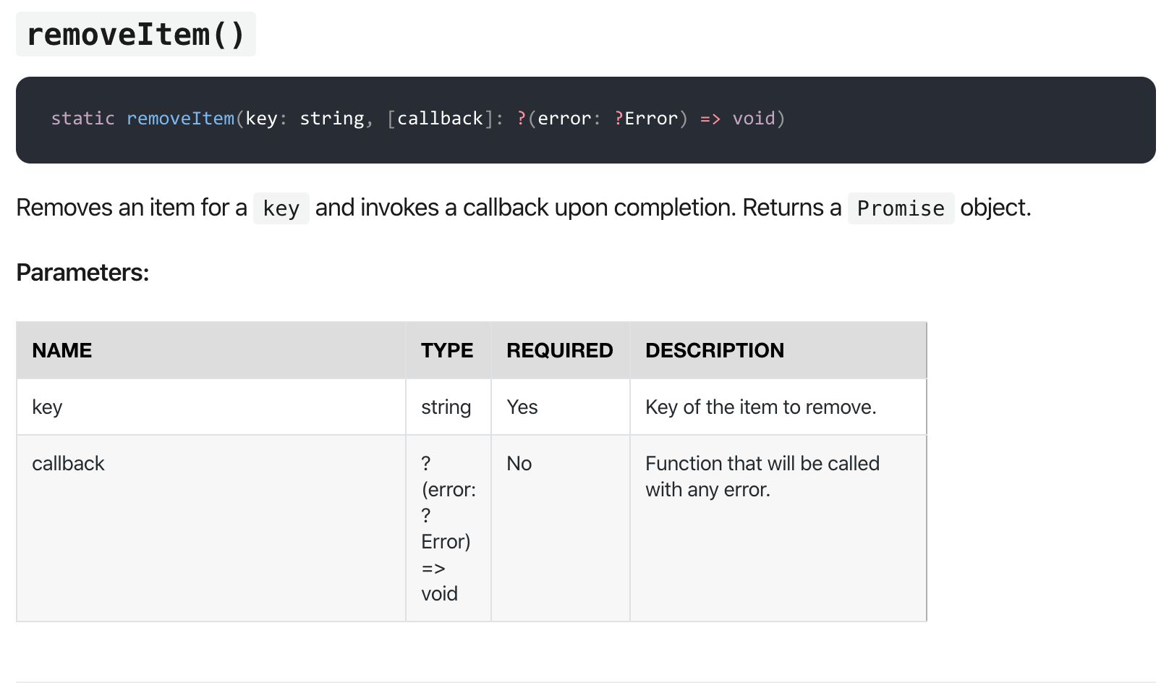
Using AsyncStorage
Pushing Data - AsynchStorage.setItem(key, val)
Fetching Data - AsynchStorage.getItem(key)
Removing Data
year : 97
Hei : 175
Wei : 75
Jedi ID

Slide 12
Using AsyncStorage
Pushing Data - AsyncStorage.setItem(key, val)
Fetching Data - AsyncStorage.getItem(key)
Removing Data - AsyncStorage.removeItem(key)
Clearing - AsyncStorage.clear()
All keys - AsyncStorage.getAllKeys()

Slide 13
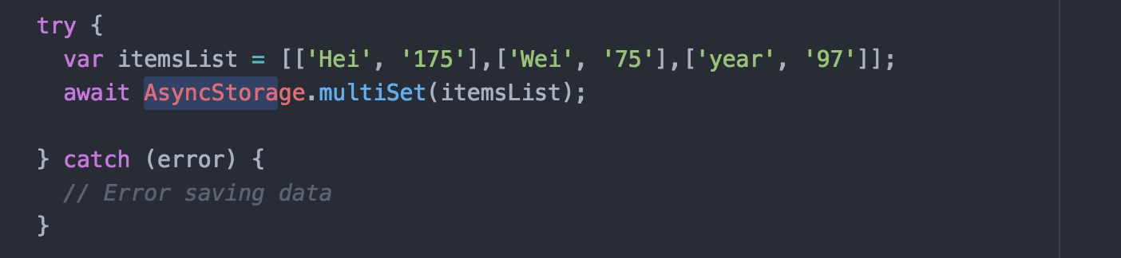
Using AsyncStorage
Multi pushing
Jedi ID

Slide 14
Using AsyncStorage
Multi pushing
year : 97
Hei : 175
Wei : 75
Jedi ID

Slide 15
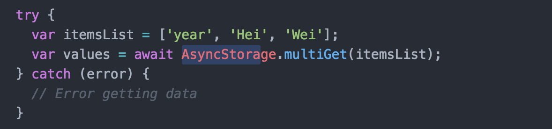
Using AsyncStorage
Multi pushing
Multi getting
year : 97
Hei : 175
Wei : 75
Jedi ID

Slide 16
Using AsyncStorage
Multi pushing
Multi getting
year : 97
Hei : 175
Wei : 75
[[‘year’,‘97’], [‘Hei’,‘175’], [‘Wei’,‘75’]]
Jedi ID

Slide 17
Using AsyncStorage
Pushing Data - AsyncStorage.setItem(key, val)
Fetching Data - AsyncStorage.getItem(key)
Removing Data - AsyncStorage.removeItem(key)
Clearing - AsyncStorage.clear()
All keys - AsyncStorage.getAllKeys()
Multi pushing - AsyncStorage.multiSet(array<array<string>>)
Multi getting - AsyncStorage.multiGet(array<string>)

Slide 18

NOTE
All functions of AsyncStorage are asynchronous (Did that surprise you? :o) Make sure you use async/await with it to get desired result

Slide 19

Overview for today
AsyncStorage
SecureStore
PouchDB
Build a to-do list

Slide 20
Overview for today
AsyncStorage
SecureStore
PouchDB
Build a to-do list

Slide 21


Secure Storage

Slide 22
SecureStore
Provides a way to encrypt and securely store key–value pairs locally on the device. Each Expo project has a separate storage system and has no access to the storage of other Expo projects.
.
.
.
.
.
.
.
Loc : CA
.
.
Age : 20
Loc : CA
Hei : 175
Name : Abd
Fav : World
Wei : 75
Tinder
NYT
Jedi ID

Slide 23
SecureStore
Provides a way to encrypt and securely store key–value pairs locally on the device. Each Expo project has a separate storage system and has no access to the storage of other Expo projects.
Loc : CA
Age : 20
Loc : CA
Hei : 175
Name : Abd
Fav : World
Wei : 75
Tinder
NYT
Jedi ID

Slide 24
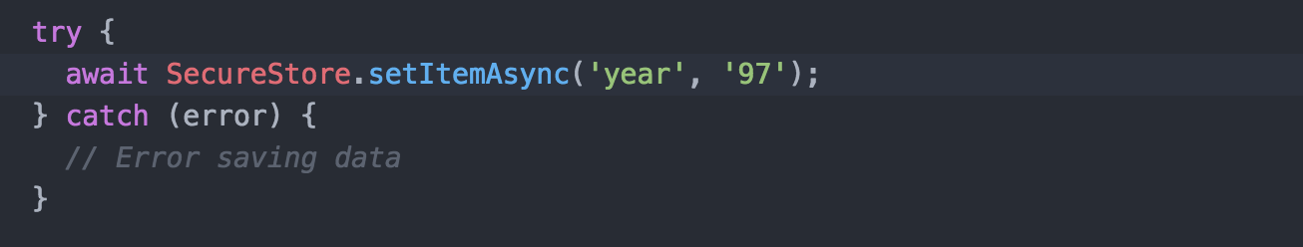
Using SecureStore
Pushing Data

Slide 25
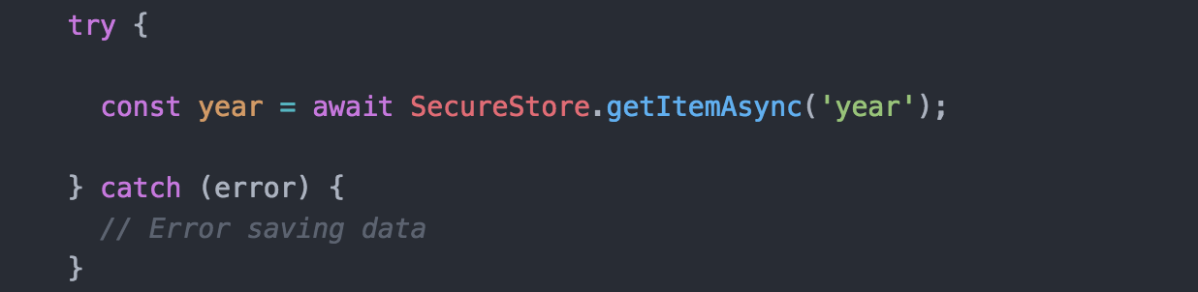
Using SecureStore
Pushing Data
Getting Data

Slide 26
Using SecureStore
Pushing Data - SecureStore.setItemAsync(key, value, options)
Getting Data - SecureStore.getItemAsync(key, value, options)
Deleting Data - SecureStore.deleteItemAsync(key, value, options)
Notes:
No multis/collective data actions

Slide 27
Overview for today
AsyncStorage
SecureStore
PouchDB
Build a to-do list

Slide 28
Overview for today
AsyncStorage
SecureStore
PouchDB
Build a to-do list

Slide 29
PouchDB
PouchDB is an in-browser database that allows applications to save data locally, so that users can enjoy all the features of an app even when they're offline. Plus, the data is synchronized between clients, so users can stay up-to-date wherever they go.

Slide 30
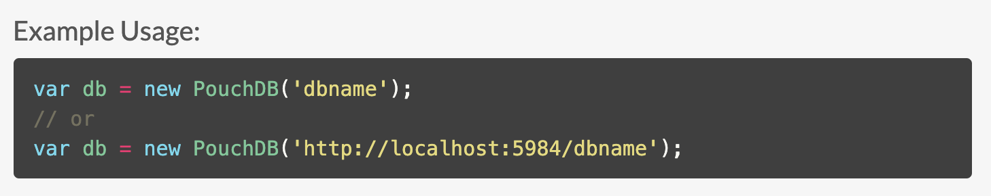
PouchDB
https://pouchdb.com/api.html
Initialize via name
Initialize via API URL
Initializing DB reference

Slide 31

PouchDB
Property-value pairs
Putting data
Upon success, execute this code
Upon error, execute this code

Slide 32
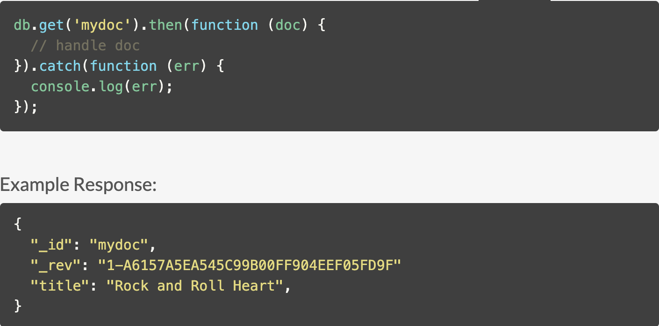
PouchDB
Getting data
Return object with id “mydoc”

Slide 33

PouchDB
Batch putting
Specify an array of objects

Slide 34
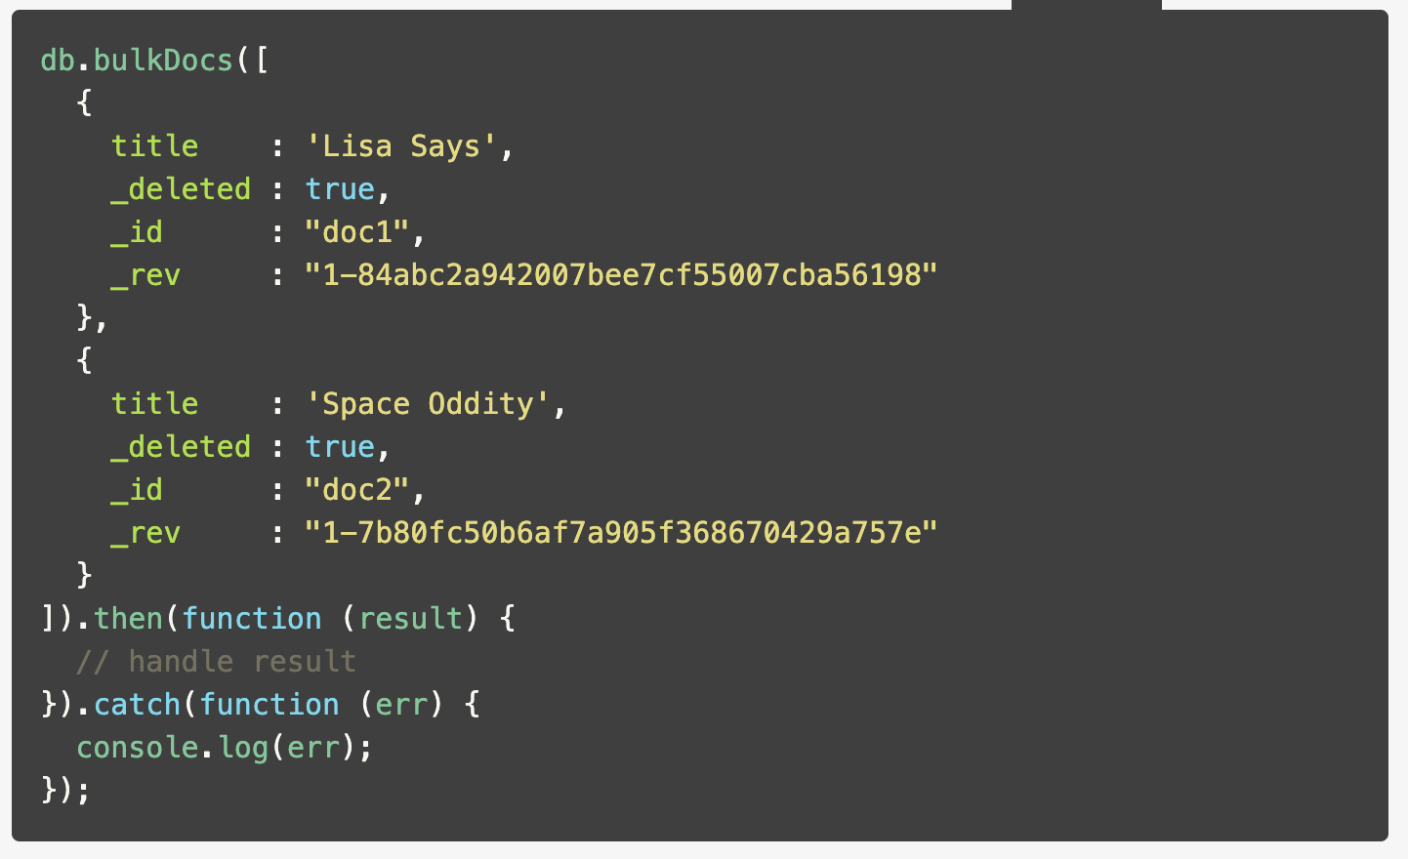
PouchDB
Batch deleting
To delete, set the _deleted flag to be true

Slide 35
Overview for today
AsyncStorage
SecureStore
PouchDB
Build a to-do list

Slide 36
Overview for today
AsyncStorage
SecureStore
PouchDB
Build a to-do list

Slide 37

Exercise
Notes:
No multis/collective data actions

Slide 38
CS47: Cross-Platform Mobile Development
Lecture 4B: AsyncStorage, SecureStore and PouchDB
James Landay
Abdallah AbuHashem
Tiffany Manuel
Cisco Vlahakis
Vy Mai
Fall 2019
https://cs47.stanford.edu
cs47-fall19.slack.com

